Slide 1
SDSS
Scholarship Presentation
November 16, 2020
Notes:
A very similar presentation to what you will see this evening was presented to grade 12 students on October 2, 2020. We had over 70 students attend our virtual session.

Slide 2
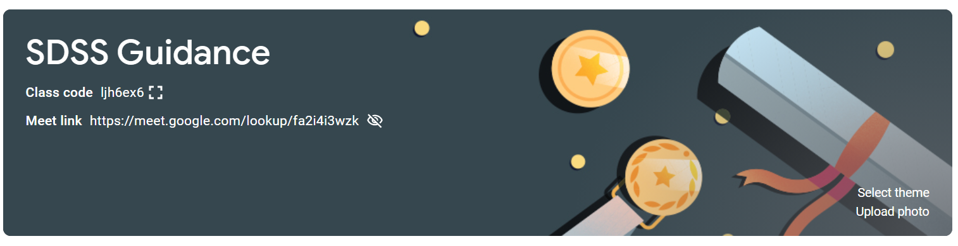
Where Students can find Information
Notes:
Students can find information on all things related to guidance on our google classroom and our grade 12’s were required to sign up for this class during the guidance Post-Secondary Planning visits that took place on September 20 and October 1st.

Slide 3
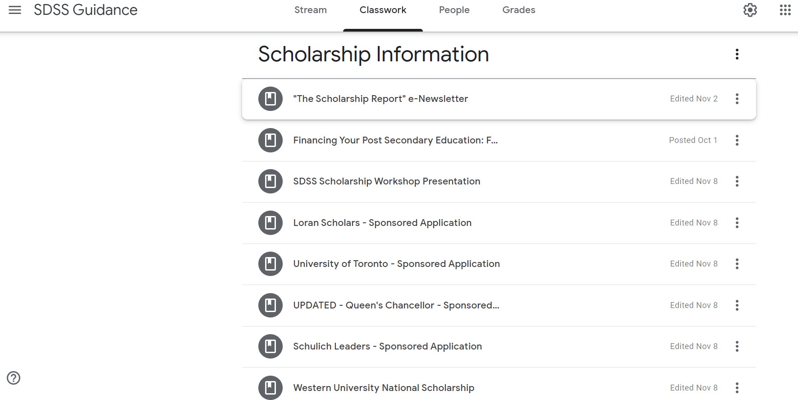
Where Students can find Information
Notes:
There is a Scholarship Information section on the classroom where students can find information about both school and self-nominated scholarships. We highly encourage all students to read through The Scholarship Report, which is presented 4 times per school year and includes information about both school and self nominated scholarships, as well as information on how to write and improve your application.

Slide 4
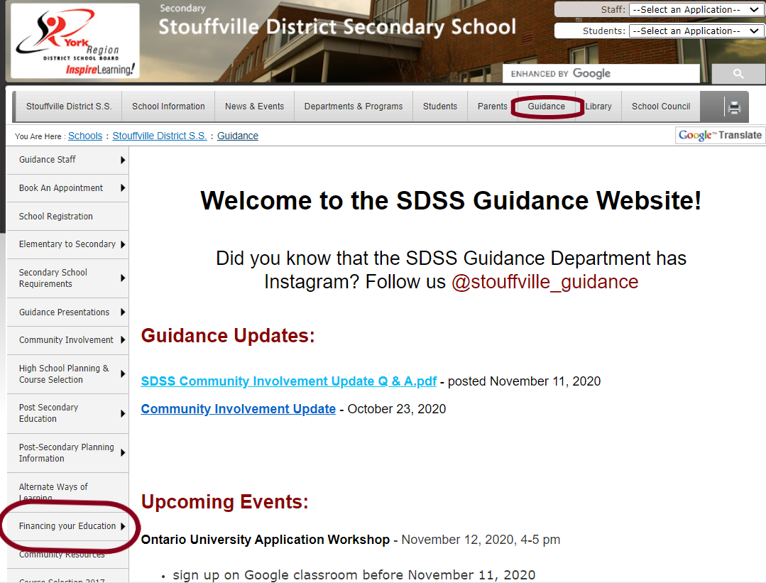
Where Parents can find Information
Notes:
Parents can find information about all things guidance on the SDSS School website under the guidance tab. Scholarship information is found under the Financing your Education tab on the left hand side. Here you will find information about our School-Sponsored Scholarships, details about Academic Awards given at SDSS such as honour roll and Ontario Scholar, and information about other scholarships, bursaries, and financial Aid

Slide 5
How Much does Post-Secondary Education Cost?
According to Statistics Canada, students in undergraduate programs paid, on average, $6,463 for a full year of study in 2019/2020. The average cost of college tuition for one academic year in a diploma program is $2,400 while bachelor degree programs at colleges cost approximately $6,100. (Do keep in mind that tuition varies by program and province.).
There are also other expenses to consider such as fees, textbooks, equipment, and supplies; residence + meal plan or off-campus housing and food; and miscellaneous items, e.g., cell phone, clothing, recreation, transportation, etc.

Slide 6
How Can Students Pay for Their Education?
• Family Assistance
• Government Funding (OSAP)
• Part-time Jobs/Summer Jobs
• RESP’s
• Savings
• Scholarships, Bursaries and Awards
Notes:
Not every student will have access to all of the listed options. However, you may want to consider your eligibility for scholarships, bursaries, and awards.

Slide 7
Scholarships – based on merit (criteria varies) - application required
Bursaries – based on financial need - applied to after you have accepted an offer of admission or graduated high school; do not need to pay back
Awards - given for outstanding achievement - application required (available in April)
Scholarships, Bursaries and Awards

Slide 8
Types of Scholarships
Offered by Post Secondary Institutions.
Entrance Scholarships – marks based; often no application required; offered at time of offer of admission
Faculty & Presidential Scholarships – application required; specific criteria indicated
In-course Scholarships – found through the student services department of the post-secondary institution; apply late August into the fall
Offered by Outside Groups interested in donating money to students.
granted by corporations, community groups, and foundations
check with your own & your parents’ employers, unions, banks, investment companies, insurance companies, anywhere that sends you or your parents addressed mail.
Notes:
Earning a scholarship is a process that can start as early as grade nine. A typical winner of most scholarships has consistently demonstrated, over an extended period of time, that they are involved in a number of activities that illustrate they are well-rounded individuals. Students with the highest marks do not automatically win scholarships. Many of the groups awarding scholarships are looking for good overall citizens. The general criteria are: high academic achievement (over 80%);community Involvement (beyond the 40 hours needed to graduate from high school) and extra curricular participation (athletics, councils, clubs, teams). Many scholarships require letters of recommendation - so it is important for students to considered 2 or 3 teachers who may be able to speak on their behalf - these can be teachers, activity leaders, and or coaches.

Slide 9
School Nominated Scholarships
These scholarships call upon the Stouffville District Secondary School Scholarship Committee to submit one or more candidates for consideration.
Based on academic achievement (85%+), creative and original thinking and ongoing leadership
The fact that the school has nominated an individual is not a guarantee that the student selected will receive that scholarship.
The nominated student must still go through a selection process in competition with all other school
nominated candidates.
Notes:
THese awards have internal deadlines - which is usually one to two weeks before the official deadline.
The decision is based on an adjudication of the applications, transcripts and references reviewed by the Scholarship Committee made up of faculty from the school
Once the committee meets and an applicant is chosen, they are notified to send their package along or that an invitation to apply will be coming from the official scholarship site.

Slide 10
School Nominated Scholarships
Scholarship information and timelines can be found
Here
Loran Scholarship - October
U of T Book Award & National Scholarship - October
Queen’s Chancellor Scholarship - November 20, 2020
Schulich Leader Scholarship - January 15, 2021
Western University National Scholarship - January 25, 2021

Slide 11
Self-Nominated Scholarships
Students apply directly for these scholarships and do not need “endorsement” or nomination from the school
However, it is highly recommended students meet with their counsellor or a teacher to help them review their Scholarship application

Slide 12

Where to Start the Search:
The Scholarship Report - available on the Guidance Google Classroom. Contains scholarship listings with descriptions and submission deadlines
Scholarships Canada and Scholar Tree - Scholarships, bursaries, awards, tips
Ontario Universities Info

Slide 13
Scholarship Advice
Although scholarship criteria can vary, a general statement of advice still applies.
Should you be interested in applying for scholarships, it is rare that only academic achievement is sufficient.
Successful candidates are those who are able to demonstrate extra-curricular involvement either within the school or within the community.
Such involvement should span a considerable period of time, not just the last year or two.
In addition to this, leadership experience is strongly recommended, as scholarship committees view this as an asset, and in some cases,
as a requirement.
Getting Prepared - Start NOW !!

Slide 14
Other Considerations
Getting Prepared - Start NOW !!
It’s never too early to start thinking about scholarships!
Be aware of your social media presence.
Students are encouraged to keep track of their participation and leadership at school and in their community as well as any certificates of achievement, recognition, and awards they receive during high school
Where possible (and safe during these times) get involved
Complete as many scholarships as you can and remember to incorporate your experiences in your responses - don’t re-write your resume in the answer section

Slide 15
Sample Questions
How has the COVID-19 pandemic affected you and what have you done in response to the pandemic?
Describe your most significant volunteer contribution. Why did you do it? How did it affect others?
Describe a time when you took the initiative to address an unmet need at school or in the community. What was the need? What did you do? What was the impact?
Describe a leadership role that was meaningful to you. How did you establish a goal? Describe the steps you took to reach the goal. What were the results? What challenges did you face within your group and how did you resolve them? Overall, what did you learn about leading others through this experience?
Getting Prepared - Start NOW !!

Slide 16

Thank You!
Getting Prepared - Start NOW !!

