Slide 1
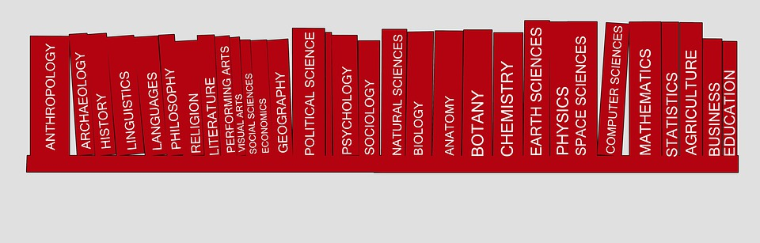
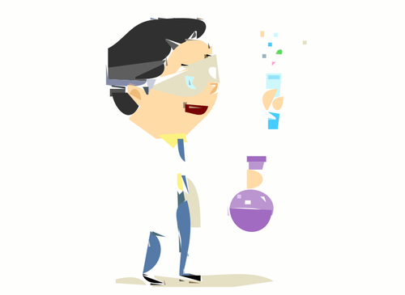


APA Style
(American Psychological Association)
Step by Step
Process-
Science

Slide 2
Learning Goals
I am learning to….
Format my references using APA style.
Access information to assist in creating a properly formatted APA reference list.
Identify what needs to be cited and why

Slide 3


When to use APA?
At Sutton D. H. S, APA style formatting is used in the social science disciplines such as psychology, sociology, family studies and some science courses.

Slide 4


Why should I cite?
Because it identifies and credits sources used in research papers, essays, or projects
To show your reader that you have done proper research
To acknowledge other people’s research and ideas
To be able to access the material at a later date
** To avoid plagiarism

Slide 5
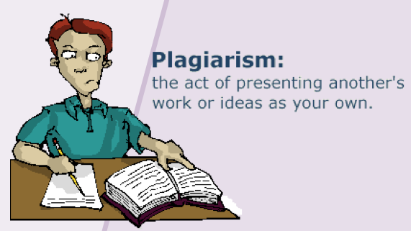
What is plagiarism?

Slide 6
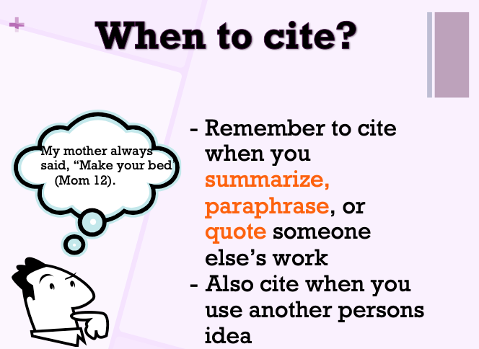

Slide 7
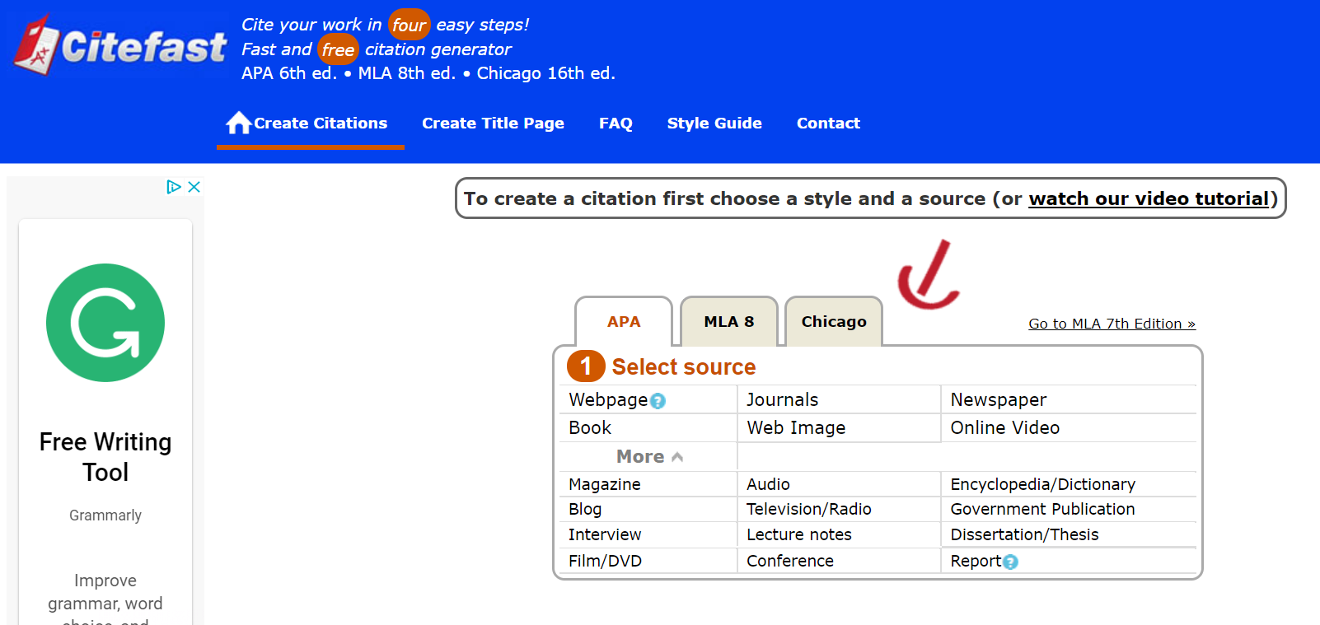

Where to go for APA help
Citefast.com
- online tool to generate your APA citations
Notes:
https://www.citefast.com/?s=APA#_Webpage

Slide 8
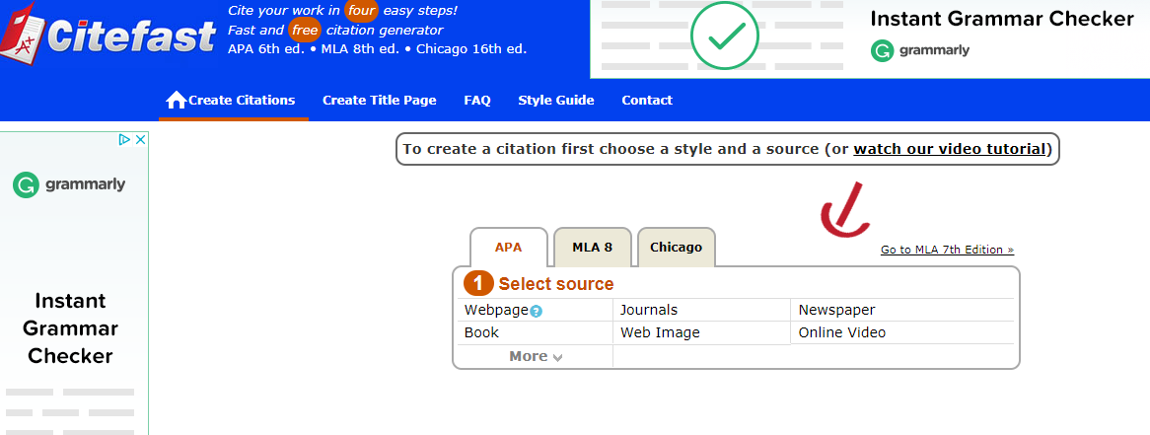
Select source type (book, website etc…)
Enter key information
Extend your reference: Click on Manual Entry to add additional details for each source used.
Copy and paste details into your final reference

Slide 9

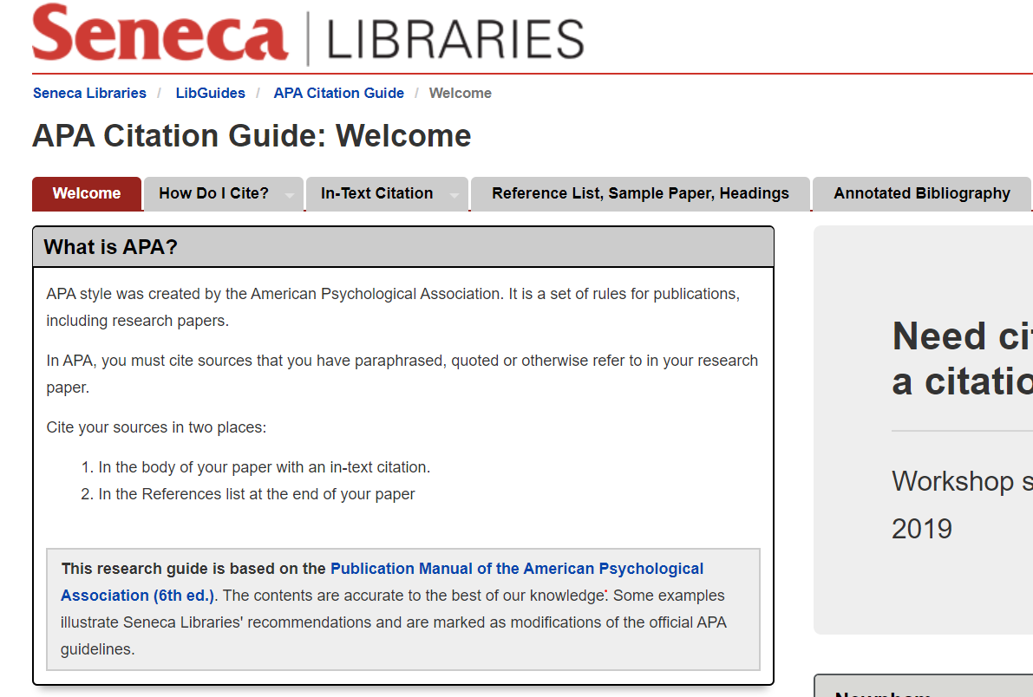
Other Areas to use to support your references
Seneca College APA Manual reference support
Notes:
https://seneca.libguides.com/c.php?g=20762&p=121143

Slide 10
Reference List - Exemplar
Hart-Davis, A. (2014). The science book. New York, New York: DK.
Lung Association. (2016, December 10). Respiratory system | the lung association.
Retrieved from https://www.lung.ca/lung-health/lung-info/respiratory-system
Pempek, T.A., Yermolayeva, Y.A., & Calvert, S.L. (2009). College students' social networking
experiences on Facebook. Journal of Applied Developmental Psychology, 3(2),
227-238. https://doi.org/10.1016/j.appdev.2008.12.010

Slide 11
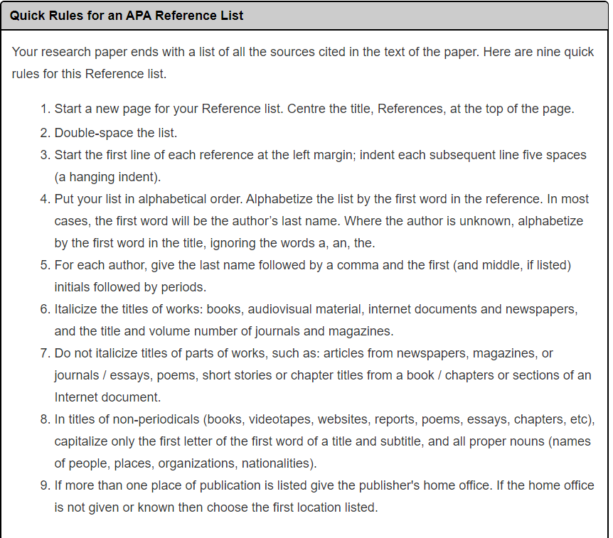
Formatting to Remember
Notes:
https://seneca.libguides.com/c.php?g=20762&p=121144

Slide 12
Examples of Formatting
Alphabetize your sources using the author’s last name.
A-Z
Double space between each source.
Perrella (2019) How to reference
Perrella (2019) How to reference
Indent after the first line of a source.
Lung Association. (2016, December 10). Respiratory system | the lung association.
Retrieved from https://www.lung.ca/lung-health/lung-info/respiratory-system

Slide 13
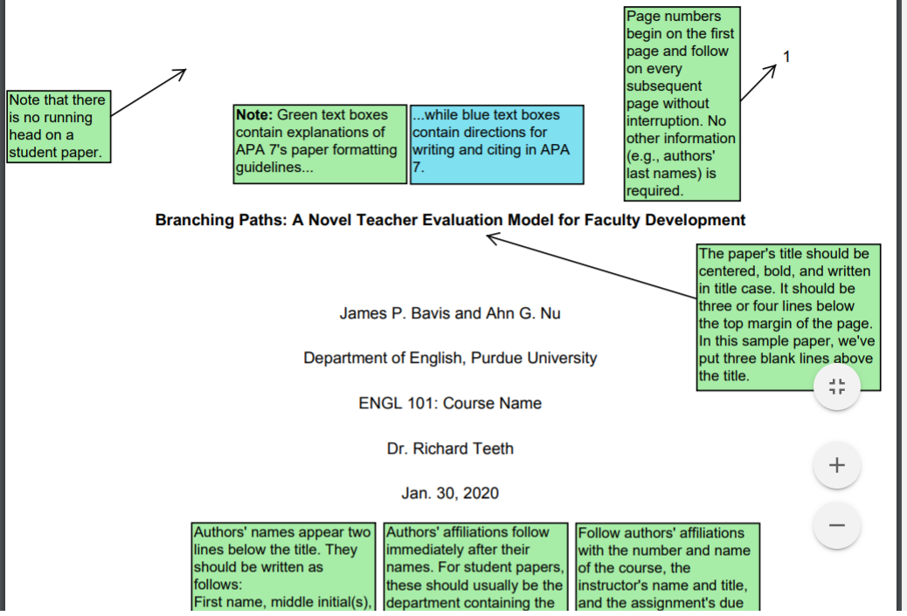

Sample of Student Paper
Check out the following link for a sample paper in APA Style
l

Slide 14
Success Criteria
I have learned to….
Format my references using APA style.
Access information to assist me when I create an APA formatted reference list.
Identify what information needs to be sourced and use the correct format in my projects.

