Slide 1
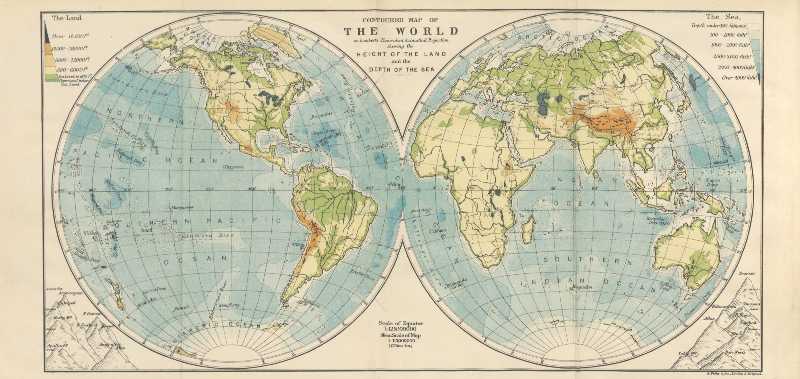
Chicago Manual Author-Date Style
for Geography

Slide 2
Learning Goals
I will learn to….
Access information to assist in creating a bibliography following Chicago Manual format.
Format my bibliography using Chicago Manual style.
Access resources to assist in creating in-text citations following the Chicago Manual Author-Date format.
Identify what needs to be cited and why.

Slide 3
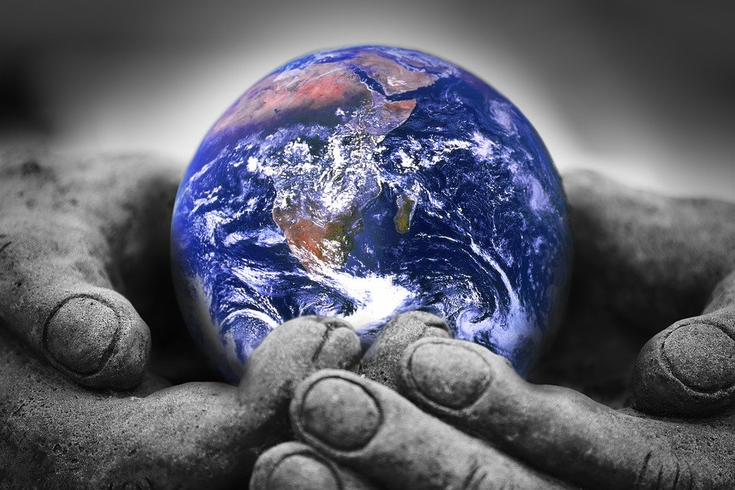
When to use this Chicago Style Author-Date format?
This particular Chicago style is used specifically in Geography classes

Slide 4


Why should I cite?
Because it identifies and credits sources used in research papers, essays, or projects
To show your reader that you have done proper research
To acknowledge other people’s research and ideas
To be able to access the material at a later date
** To avoid plagiarism

Slide 5

What is plagiarism?

Slide 6
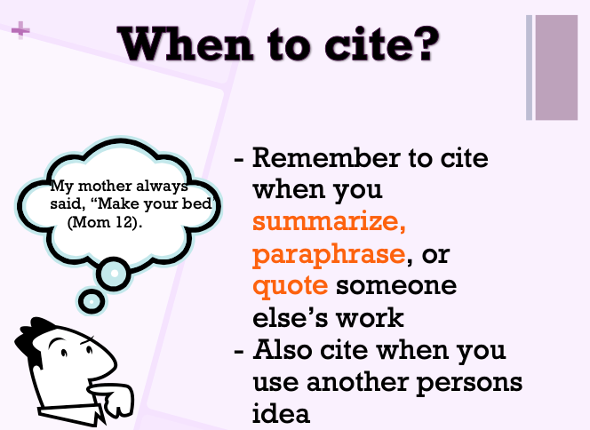

Slide 7
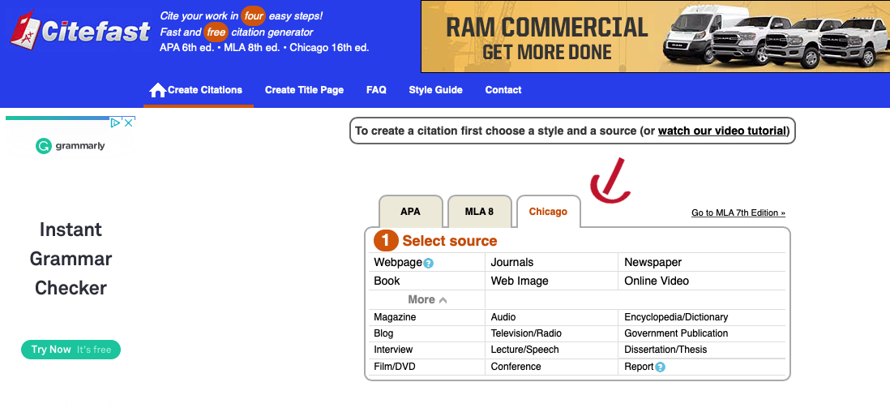

Where to go for Chicago Manual Style Bibliography help
www.Citefast.com
- online tool to generate Chicago Style citations
Notes:
https://www.citefast.com/?s=Chicago#_Webpage

Slide 8
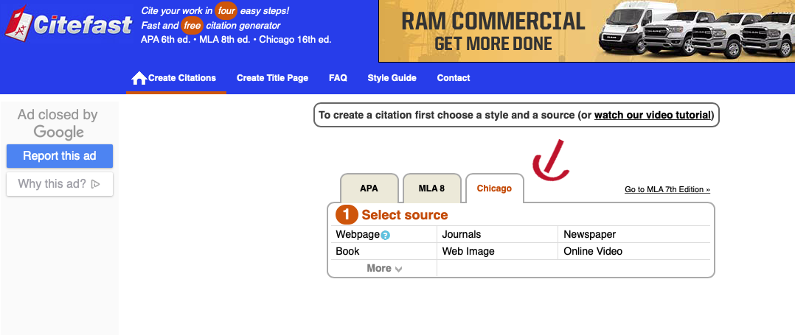
Select source type (book, website etc…)
Enter information
To extend your reference: Click on Manual Entry and add additional details for source used.
Copy and paste details into your final reference

Slide 9
Bibliography - Exemplar
Book:
Connell, Tula. “Making the World Safe for Workers: Labor, the Left, and Wilsonian
Internationalism by Elizabeth McKillen.” Labor 15, no. 4. 2018: 151-152.
Webpage:
Ducksters Educational Site. "Earth Science for Kids: Rocks, Rock Cycle, and Formation."
Ducksters: Education Site. Accessed January 10, 2020.
https://www.ducksters.com/science/rocks.php.
Webpage Article:
National Geographic Society. "The Rock Cycle." National Geographic Society. Last modified
October 29, 2019. https://www.nationalgeographic.org/encyclopedia/rock-cycle.

Slide 10
Remember to use In-Text Citations
In-text citations are used when you are directly quoting, paraphrasing or summarizing someone else’s words or ideas in your project.
Remember to include parenthesis (), the Author’s last name, year of publication and page (if applicable) directly after your citation.
Example using a quote or summary: Carbon dioxide is the main cause of human-induced climate change (Government of Canada 2019).
Other Examples:
Book or Journal Article: (Grazer and Fishman 2015, 12)
Webpage: (Government of Canada 2019)
For More support and examples,

Slide 11
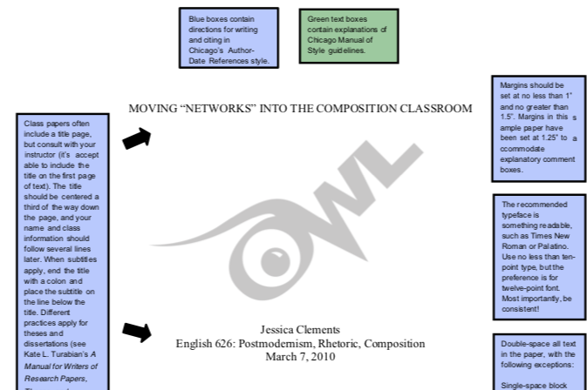

Sample Paper
Use this exemplar for In-Text citation format.
Check out the following link for a sample paper in Chicago Style using Author-Date format

Slide 12
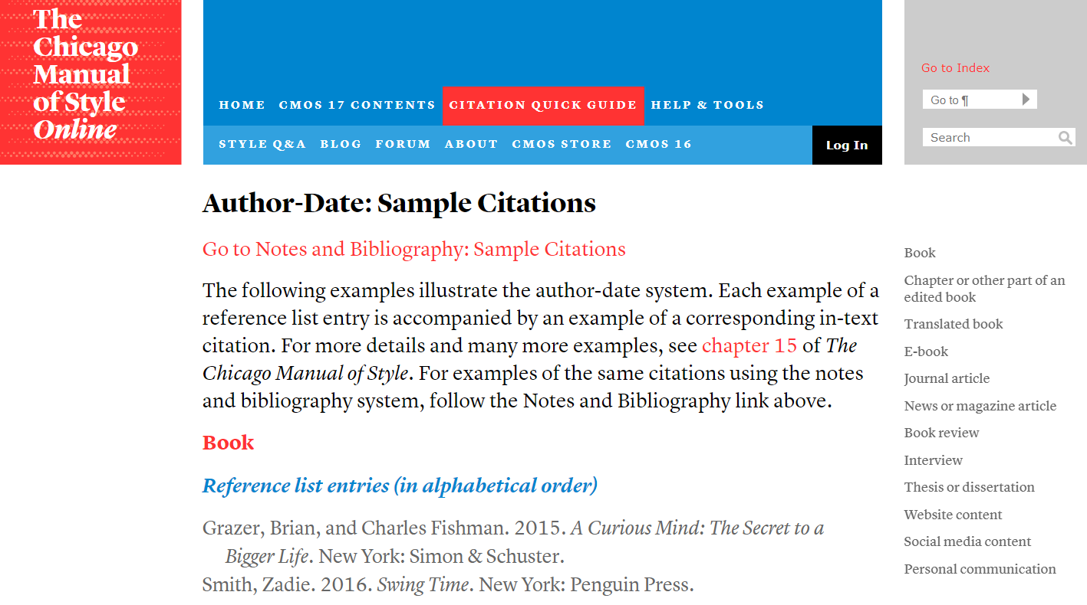
Other Areas to use to support your sources/citations
Need help with your reference list
Notes:
https://www.lib.uwo.ca/files/styleguides/ChicagoNotesBibliography.pdf

Slide 13
Success Criteria
I can….
Access resources to assist me when I create a bibliography following Chicago Manual format.
Format my bibliography using Chicago Manual style
Format in-text citations using Chicago Manual Author-Date.
Identify what information needs to be sourced and use the correct format in my projects.

