Slide 1




Chicago Manual Style
History, Music, Fine Arts and Business

Slide 2
Learning Goals
I will learn to….
Format my references using Chicago Manual style.
Access information to assist in creating a bibliography following Chicago Manual Style.
Identify what needs to be cited and why

Slide 3


When to use Chicago Style?
At Sutton D. H. S, Chicago style formatting is used in History, Business and Fine Arts (i.e Art, Music)

Slide 4


Why should I cite?
Because it identifies and credits sources used in research papers, essays, or projects
To show your reader that you have done proper research
To acknowledge other people’s research and ideas
To be able to access the material at a later date
** To avoid plagiarism

Slide 5

What is plagiarism?

Slide 6
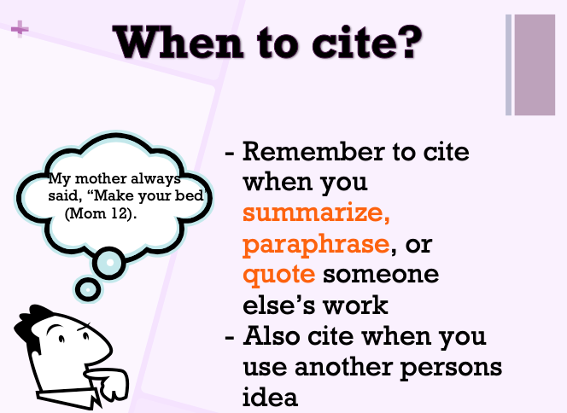

Slide 7
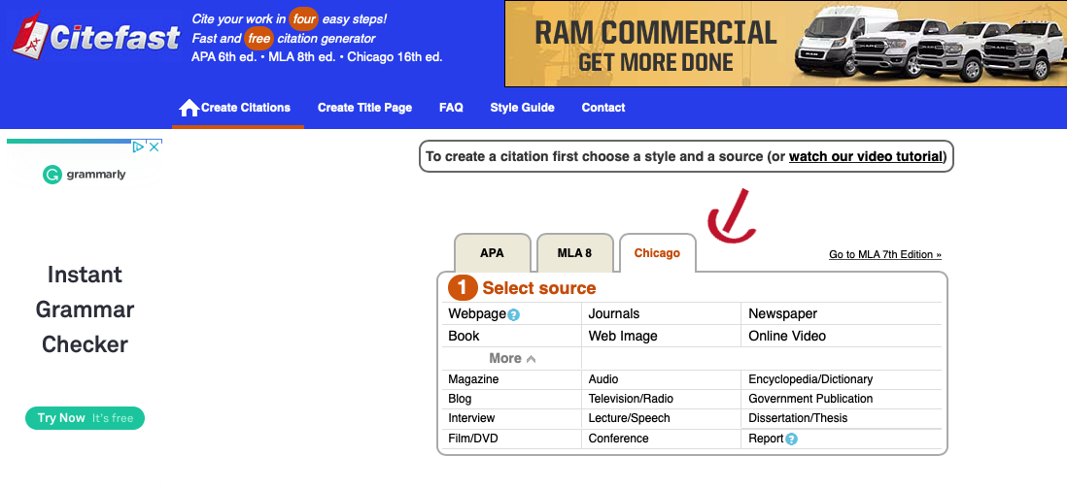

Where to go for Chicago Manual Style help
www.Citefast.com
- online tool to generate Chicago Style citations
Notes:
https://www.citefast.com/?s=Chicago#_Webpage

Slide 8
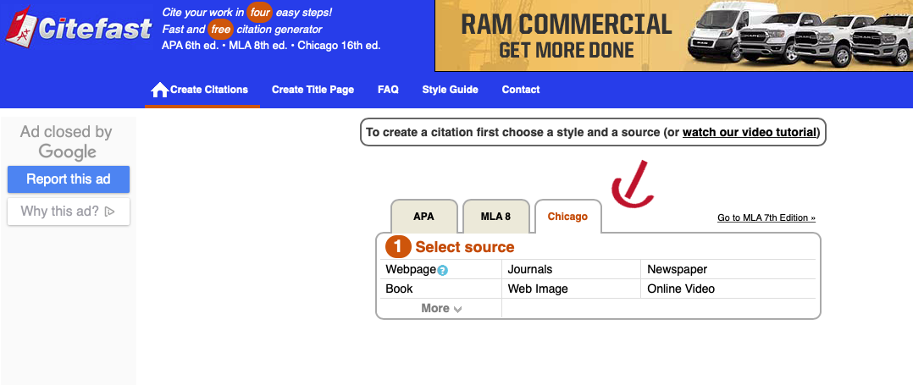
Select source type (book, website etc…)
Enter information
To extend your reference: Click on Manual Entry and add additional details for source used.
Copy and paste details into your final reference

Slide 9
Bibliography - Exemplar
Book:
Connell, Tula. “Making the World Safe for Workers: Labor, the Left, and Wilsonian
Internationalism by Elizabeth McKillen.” Labor 15, no. 4 (2018): 151-152.
Webpage:
Scapelliti, C. "The 12 Most Influential Guitarists of All Time' and Their Signature Styles."
GuitarPlayer.com. Last modified January 22, 2018.
https://www.guitarplayer.com/guitaraficionado/the-12-most-influential-guitarists-of-all-ti
me-and-their-signature-styles.
Webpage Article:
Kallmann, Helmut. "Music History." The Canadian Encyclopedia. Last modified
March 4, 2015. https://www.thecanadianencyclopedia.ca/en/article/music-history.

Slide 10
Remember to use Footnotes/Endnotes
- Footnotes appear at the bottom of each page
- Endnotes appear as one list at the end of the paper on a separate sheet of paper, before the bibliography
- Citations must be numbered from start to finish
- If you have used 3 citations, there will be 3 end/footnotes even if they are from the same source (each with its own number)

Slide 11
Exemplar - Footnotes/Endnotes Formatting
While this may be true, some felt that it would never be proven.¹
Lomax explains that only thirty such organizations exist.²
“Music in Canada has paralleled the basic European style periods from the baroque to the classical, romantic and contemporary.”³
Book Exemplar:
Jonathan Smith. The World As We Know It (Toronto: McGraw Hill Ryerson,
2011), 36.
Webpage Exemplar:
Catherine H. Poholek, Prohibition in the 1920s: Thirteen Years That Damaged
America, May 6, 1998. http://www.geocities.com/Athens/Troy/4399.
Webpage Article Exemplar:
Helmut Kallmann, "Music History," The Canadian Encyclopedia, last modified
March 4, 2015, https://www.thecanadianencyclopedia.ca/en/article/music-history.

Slide 12
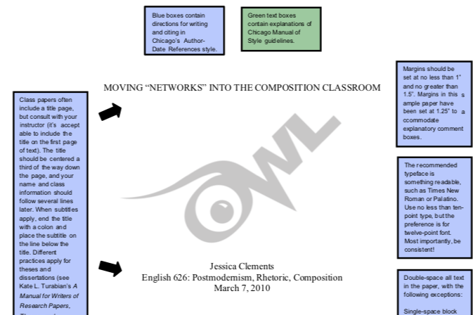


Sample Paper
Check out the following link for a sample paper in Chicago Style
l
Notes:
https://owl.purdue.edu/owl/research_and_citation/chicago_manual_17th_edition/cmos_formatting_and_style_guide/cmos_author_date_sample_paper.htm

Slide 13
Success Criteria
I can….
Format my references using Chicago style.
Access information for addition Chicago style formatted bibliography
Identify what information needs to be sourced and use the correct format in my projects.

Slide 14
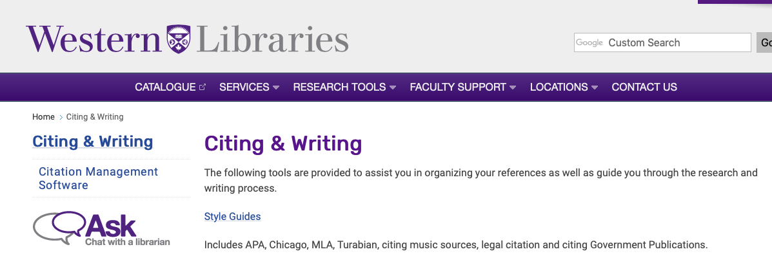
Other Areas to use to support your references
Western University Chicago Manual reference support
Notes:
https://www.lib.uwo.ca/files/styleguides/ChicagoNotesBibliography.pdf

