Slide 1
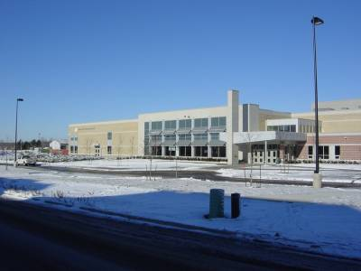
Bienvenue à l’école Secondaire
Pierre Elliott Trudeau High School
Course Selection for the Students in the
French Immersion (FI) Program
September 2016

Slide 2



The Student Support Centre
Room 116
This room is a place for students to come and
get help with school work, a place to stop in for a while to de-stress, as well as to get assistance from caring adults. Open all day, for everyone.

Slide 3

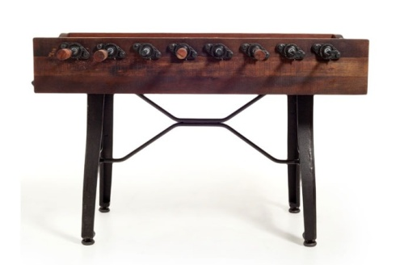

Let room 116 be your home away from home….
Basketball, foozeball, air-hockey, board games, bean-bag chairs, fridge, microwave, carpets, books, computers, and school supplies
Girls Group, Co-ed Group, Boys Group
Conferences, Trips and Events designed to help you enjoy and get support during your first year at high school

Slide 4

Programs at Trudeau
French Immersion
Advanced Placement
Specialist High Skills Major (SHSM)
English as a Second Language
Special Education (Student Services)
Alternative Education

Slide 5
Diploma Requirements (O.S.S.D.)
O.S.S.D
18 Compulsory Credits
12 Optional Credits including Dual Credits
Successful completion of Ontario Secondary School Literacy Test
40 hours of Community Involvement
Notes:
5

Slide 6

18 Compulsory Credits
4 English (1 credit per grade)
1 French
3 Mathematics
2 credits in science
1 Canadian history
1 Canadian geography
1 Arts (music, art, drama)
1 Health and Physical Education
0.5 Civics & 0.5 Career studies
Plus…..

Slide 7



Compulsory Credits
Group 1: English (including the OSSLC), French as a second language, classical languages, international languages, Native languages, Canadian and world studies, Native studies, social sciences and humanities, guidance and career education, cooperative education.
Group 2: French as a second language, the arts, business studies, health and physical education, cooperative education
Group 3: French as a second language, science(grade 11 or 12), computer studies, technological education, cooperative education

Slide 8
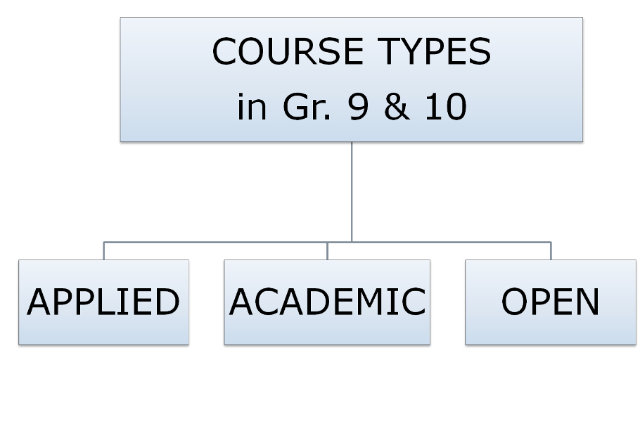
Understanding Course Types
Science
SNC1P1
Science SNC1D1
Drama
ADA101
Notes:
8
Slide is deliberately prepared so that all courses are on same continuum. One is not better than the next. Students do not drop down to a pathway or move up. Rather, they transition.
Students must consider which pathway is appropriate for their learning style.
They should rely on their Grade 8 teachers who have a good understanding of their learning style
Students do not need to take all of one pathway – they can, for example, take applied math, and academic English (depending on their interests and learning style).
Students can also transition from one course pathway to another (i.e. locally developed to applied, applied to academic or academic to applied)

Slide 9
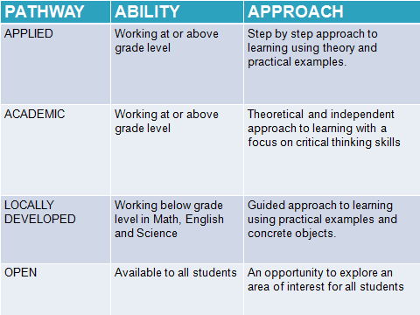
Notes:
APPLIED – Hands on. Assignments work divided into chunks. Smaller groupings
ACADEMIC – Students are able to take on larger tasks. Can be more resourceful on their own and can chunk out their work on their own.
Locally developed – Small groups. Curriculum is tailored to student needs.
Suggested - For applied – level 1
For academic level 2, 3, 4

Slide 10
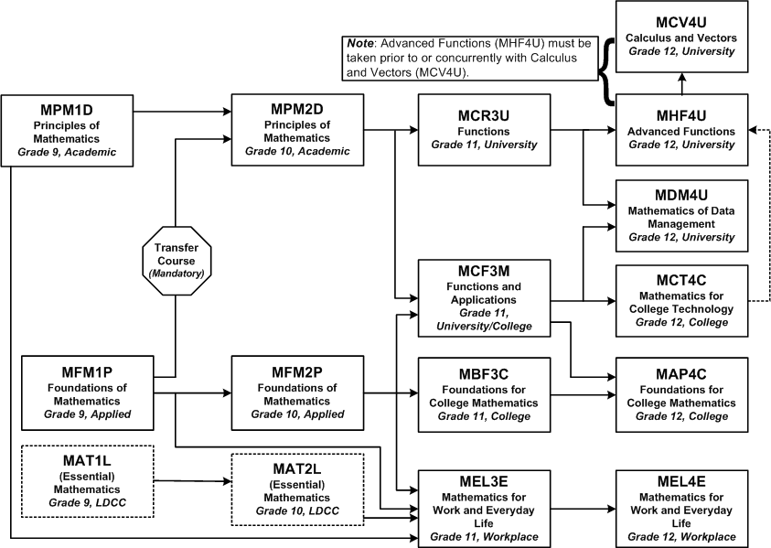
Math Pathways

Slide 11
Math Transfer Course MPM1H1
Allows students to move from MFM1P1 toMPM2D1
MPM1H1 0.5o credit combined with GLD2O1 0.5o credit
Prerequisite is MFM1P1

Slide 12
How to Read a Course Code
ENG1D1
FIF1PF
THE 3 LETTERS ARE THE SUBJECT
Letter means the course type
THE “1” MEANS GRADE 9
The “F” is French Immersion

Slide 13
The FI Certificate
To earn a French Immersion Certificate upon graduation, students must successfully complete a minimum of ten French Immersion courses.
Notes:
10 credits –COMPULSORY vs electives in the elective courses

Slide 14
International Trips and Exchanges
Exchange with La Croix Rouge School in Brest, FRANCE
International Trips to Spanish and French speaking countries are offered every other year (France, Spain)
2-3 months exchanges through ISE (International Student Exchange Program)

Slide 15
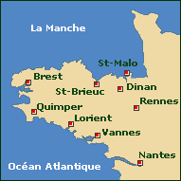
Bretagne

Slide 16
Grade 9 Core Course Selection
Academic or Applied
Français
Géographie canadienne
English
Mathematics
Science
Open Compulsory Course
Healthy and Active Living
French Immersion Electives Open Level
Art Visuels (AVI1OF)
Introduction à I’informatique (BTT1OF)
Skills for Success in Secondary School (GLS1OF)
Plus…
1 other elective course

Slide 17
Elective Courses for
Grade 9 at the Open Level
The Arts
Drama
Art
Visuels
AVI1OF
Music
Languages
Spanish
Social Sciences and the Humanities
Exploring Family Studies
Technological Studies
Exploring Technologies
Guidance
Skills for Success
GLS1OF
Dance
Exploring Computer Technologies
Business
Information and Communication Technology in Business
BTT1OF
Notes:
Open Courses
offered at all grade levels in high school
appropriate for all students in a given grade
students may take open courses to meet compulsory or optional requirements and/or for personal interest and growth
One choice in grade 9. Two choices in grade 10. More choices in grades 11 & 12
GLS1OF1 is a learning strategies course that focuses on becoming better, more independent learners by developing your literacy and numeracy skills, personalized management skills and interpersonal and teamwork skills to improve your achievement in school, workplace and community.

Slide 18
Educational Planner
Compulsory Subjects (18 required) | Required Credits | Grade 9 | Grade 10 | Grade 11 | Grade12
French Immersion |  | ¤ French Immersion* | ¤ French Immersion* | ¤ French Immersion* | ¤ French Immersion *
English | 4 | ¤ English | ¤ English | ¤ English | ¤ English
Mathematics | 3 | ¤ Mathematics | ¤ Mathematics | ¤ Mathematics
Science | 2 | ¤ Science | ¤ Science
Canadian Geography (Grade 9) | 1 | ¤ Geography*
Physical and Health Education | 1 | ¤ Phys. Ed.
Arts (music, art, or drama) | 1 | ¤
Canadian History (Grade 10) | 1 |  | ¤ History*
Civics (Grade 10) | 0.5 |  | ¤ Civics*
Career Studies (Grade 10) | 0.5 |  | ¤ Careers*
3 additional compulsory credits (see below) | 3
Optional Credits Required | 12
Minimum Credits for OSSD | 30 | Total (8) | Total (8) | Total (8) | Total (6)

Slide 19
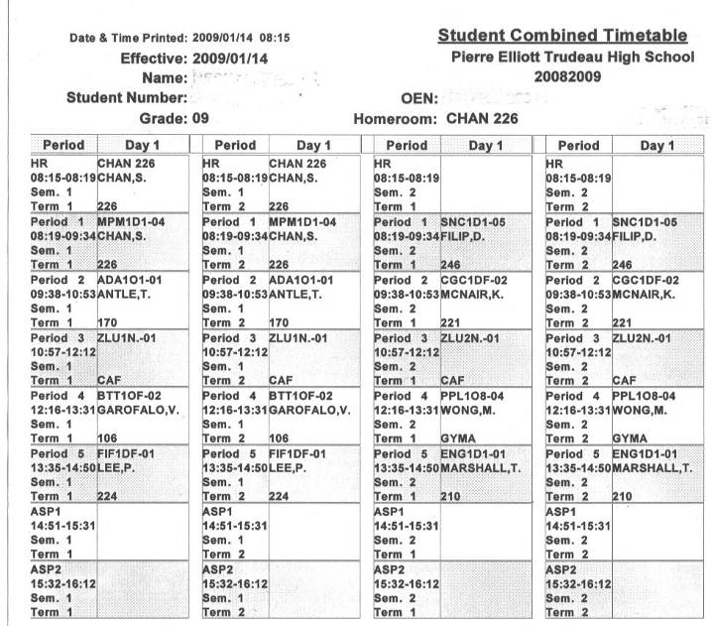
Typical Grade 9 FI Timetable
Notes:
ASP = Repertoire
FI over two semesters
HR = period 1 teacher

Slide 20
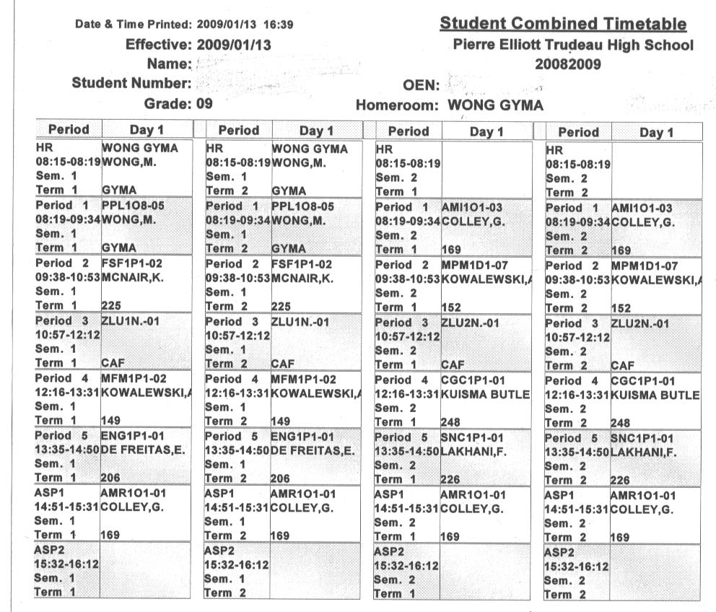
Timetable (with Music)

Slide 21
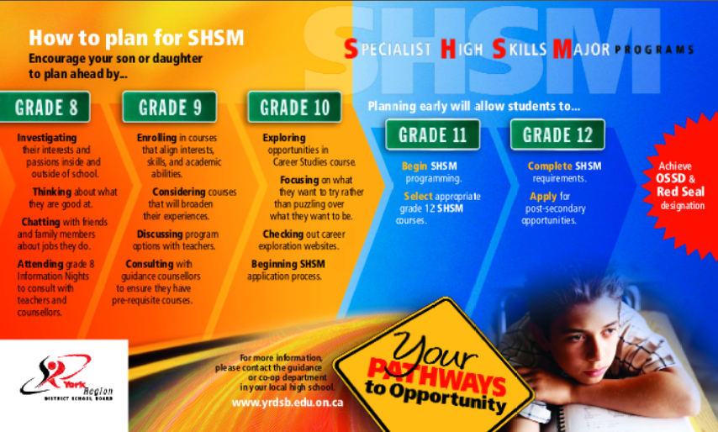
Specialist High Skills Major (SHSM)
Arts & Culture, Business and Health & Wellness
Notes:
An SHSM (Specialist High Skills Major) is a specialized program that allows students to focus and contextualise their learning in a particular economic sector.
SHSM is about allowing students to develop the requisite skills and training, certifications, and networking to allow them to make an informed transition to post-secondary.
Students go through a formal application and interview process to be eligible for admission to our SHSM program.
Students and parents see the value in the red seal and the SHSM Record.
SHSM students are recognised at graduation ceremonies
A SHSM bursary has been established.
Each school awards a trophy for the student who best demonstrates attainment of the essential skills.

Slide 22
Specialist High Skills Major (SHSM)
At Trudeau the SHSM Programs are
Arts and Culture
Business Sector
Health and Wellness
For more information contact
Ms. Diep and Mr. Annett, SHSM Coordinator’s
Notes:
An SHSM (Specialist High Skills Major) is a specialized program that allows students to focus and contextualise their learning in a particular economic sector.
SHSM is about allowing students to develop the requisite skills and training, certifications, and networking to allow them to make an informed transition to post-secondary.

Slide 23
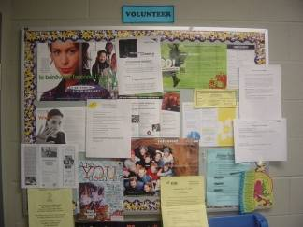
40 Hours of Community Involvement
a diploma requirement
must complete a minimum of 40 hours before graduation
YRDSB Community Involvement Guidelines is online

Slide 24

Grade 9 EQAO Math Test
Written in January by first semester math students
Written in June by all second semester math students
2 days of testing – 50 min. each day during the regular math class
Not a diploma requirement
Part of the test will count 5% towards the final mark
Accommodations provided for ESL and Special Education students

Slide 25

The Ontario Secondary School
Literacy Test
a diploma requirement
will be administered in the Grade 10 year
test based on the Ontario Curriculum Expectations for reading and writing up to the end of Grade 9
results will be reported as a pass on the transcript
Notes:
OSS 3.1.4
The test is based on curriculum expectations from across the curriculum, not just English courses.
The test will serve both to determine whether students have acquired the reading and writing skills considered essential for literacy, and to provide confirmation that those students who have completed the test successfully have attained the provincial expectations for literacy. The test will identify those students who have not demonstrated the required skills and will identify areas in which these students need remediation.
We will provide remedial assistance for students who do not complete the test successfully. The assistance will be designed to help students improve their skills so that they are better prepared to retake the literacy test.
Accommodations - must be made to ensure that students who are receiving Sp. Ed. programs and who have an I.E.P. have a fair and equal opportunity to successfully complete the test; may or may not be IPRC; same accommodations as set out in the I.E.P.
Deferrals - may include students who have been identified as exceptional and students in ESL/ELD courses
Exemptions - students whose I.E.P. indicates that the student is not working towards attainment of a diploma may be exempted; should the I.E.P. be revised so as to allow the student to work towards the attainment of the diploma, then the student could take the literacy test

Slide 26
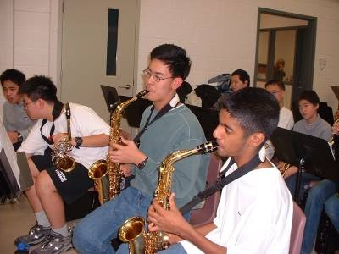
Trudeau Clubs
Yearbook
Drama Club
Octagon Club
Dance Club
Leadership Camp
DECA
Student Council
Music Ensembles
Art Council
Broadcast Team

Slide 27
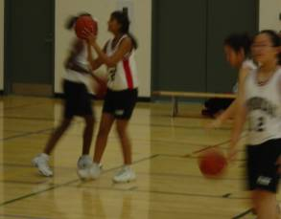


Trudeau Sports Teams
Volleyball
Basketball
Swimming
Skiing/Snowboarding
Cross-Country
Golf
Badminton
Rugby

Slide 28
Individual Program Plan (IPP)
Who am I? (Knowing Yourself
What is my plan for achieving my goals? (Making Transitions)
What are my opportunities? (Exploring Opportunities)
Education and Career Life Planning
Who do I want to become? (Making Decisions and Setting Goals)
Notes:
The four step inquiry process provides a framework that is ongoing and cyclical with students returning to the framework as they develop greater knowledge of themselves, their opportunities and how they can successfully shape their future.
The steps are not necessarily sequential, the students will continually explore and assess their knowledge of themselves, their opportunities, goals and plans.

Slide 29

Online Course Selection
How to Select Courses Using Career Cruising

Slide 30

Go to www.yrdsb.ca

Slide 31


www.yrdsb.ca
Scroll Down

Slide 32
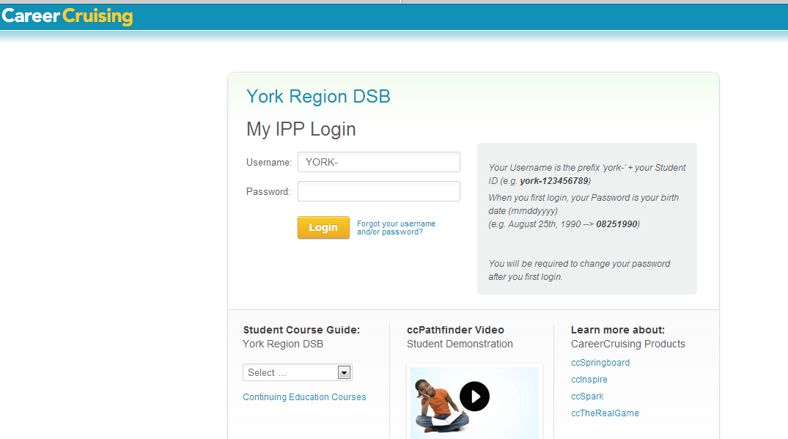
Student Login Page
Notes:
All students have a username and password. Career cruising is where students select their courses for secondary and throughout secondary school. Students can also access and keep track of their Individual Pathways Plan

Slide 33
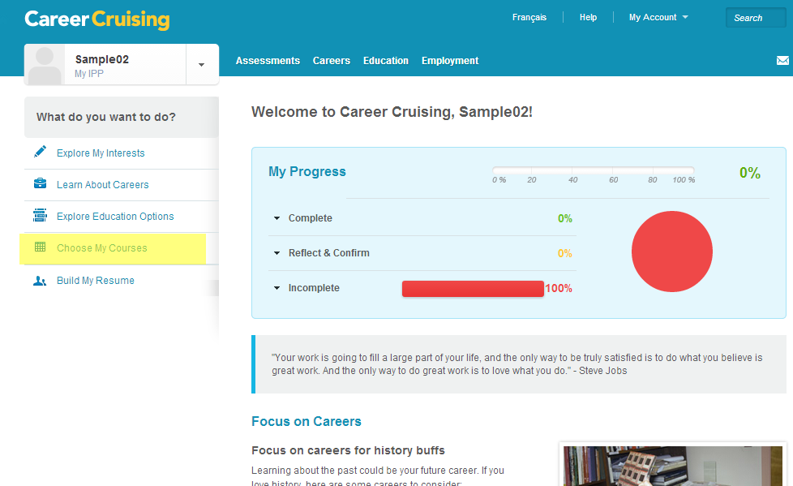
Go to: Choose My Courses

Slide 34
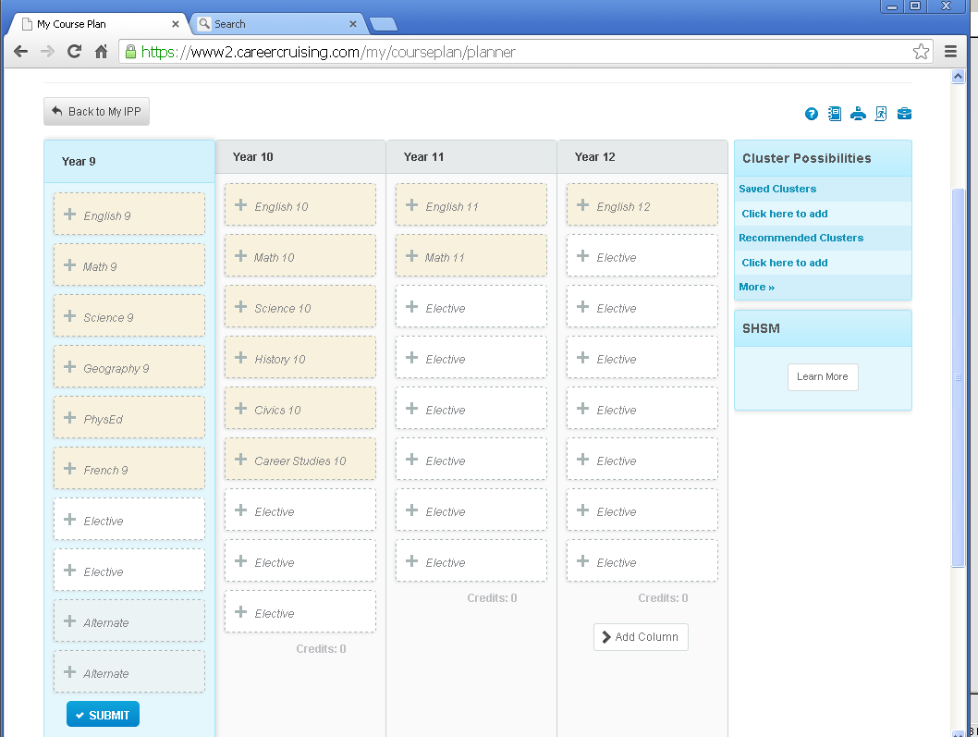
Select Courses
“+” will add course to your planner
French and Geography for FI courses
Use Elective to add additional FI Open Course

Slide 35

Alternate Courses
You must choose 2 Alternate courses
  Choose these in the same way you choose the Elective courses
  Your Alternates WILL be used
  if your Elective courses do not
  work in your timetable –
  CHOOSE WISELY!!!

Slide 36
Red and Blue Circles
The blue circle will give you additional information about the course.
The red circle prevents you from submitting the course form.
Notes:
Blue is a warning note: you could have selected a course that you have previously completed or it is advising you that you have chosen co operative education and you need to see a teacher about it to complete another application and interview process.
The red circle is alerting you to the fact that you do not have the pre-requisite course required for that course and/or speak to guidance.

Slide 37
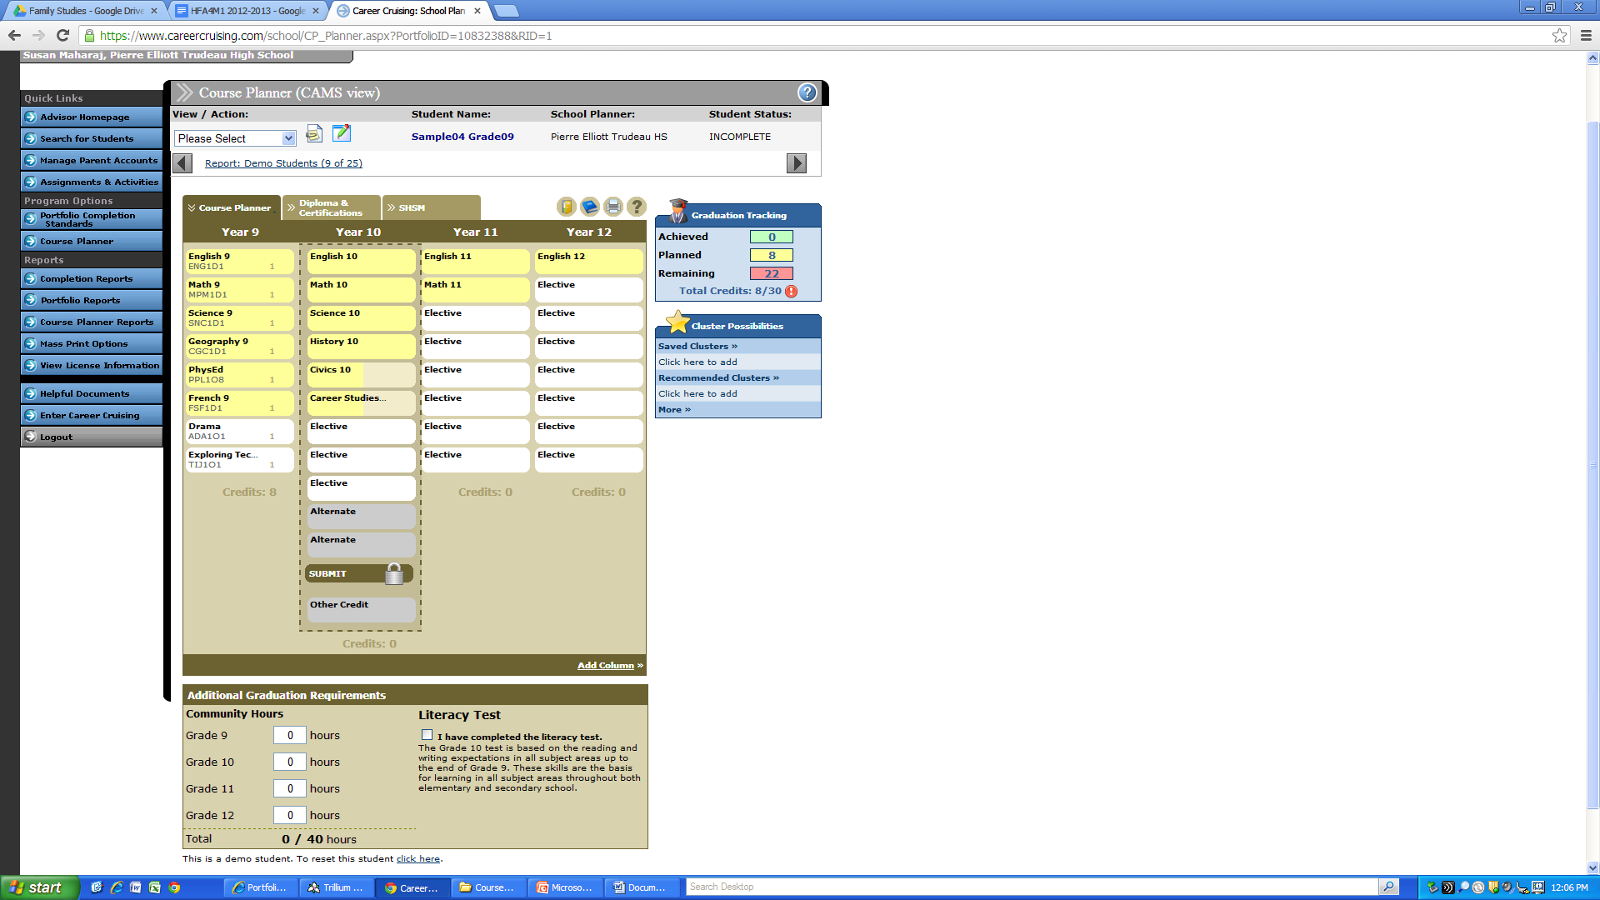
Submitting Your Course Selection
Click the “SUBMIT” button to submit the courses
Print your selections and have them signed by your parent or guardian
Hand in to your homeroom teacher

Slide 38
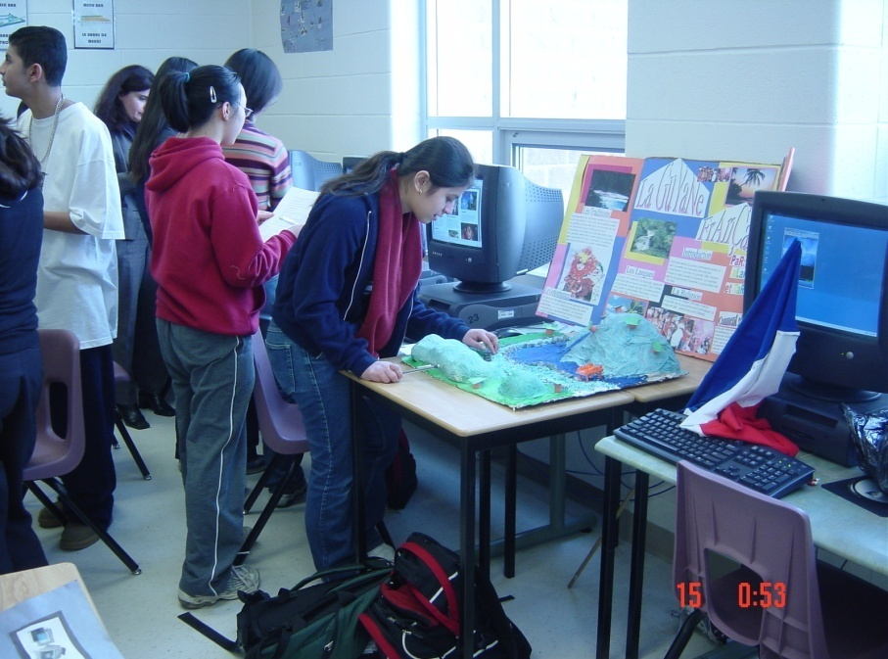
Deadlines and Due Dates
Your registration form is due to P.E. Trudeau High School by:
February 1, 2016
Course Selection forms due in Career Cruising by:
February 22, 2016
And in paper copy to P.E.Trudeau High School by:
February 26, 2016

Slide 39
Tips for Sucess
Explore a variety of subjects
Join extra-curricular activities, teams, clubs, sports
Meet new people, make new friends

Slide 40

Questions?
905-887-2216
www.yrdsb.ca
http://trudeau.hs.yrdsb.ca/
@PETHSGuidance
See you for the Course
Presentation Evening
January 14th at 7:00!

